Slide 1
Group 8 Proposal Presentation
By Salvador, Christianna, Corey, Nicholas, and Hamza

Slide 2
Abstract
Creating a Chess Game
Allow for Player vs Player and Player vs AI
Language
Python for code
Python TKinter library for GUI
Objectives
Menu that prompts game mode options
Make chessboard
Making the movement rules for each piece
Can’t make any illegal moves
Keeping score along with whose turn
Pop up for whoever is the winner and loser

Slide 3
Intro and Background (1 of 2)
Contributions will be split up in three major parts
GUI (Nicholas and Salvador)
Menus
Chessboard
Chess pieces
Chess logic and functionality (Christianna, Corey, and Hamza)
Get input from player
Piece properties (movement, is taken, position in board)
AI/Computer opponent (TBD)

Slide 4
Intro and Background (2 of 2)
Technical manuals will be utilized for making a responsive and effective application
Examples are online manuals for TKinter. Python Libraries, and group planning techniques
Several Chess applications for reference (website apps, 3D hardware rendered apps, calculator based apps, etc.)
Most popular would be the website “Chess.com”

Slide 5
Project Objectives
Create a GUI interface (menu, chessboard, pieces)
Game Logic (prevent illegal moves, piece movement, general chess rules)
Computer Opponent
Secondary Objectives (Optional):
Adding multiple difficulties for AI
Win/Lose screens
Flip chessboard for player making move
Player statistics

Slide 6
Methodology
We will be using the Waterfall Method
All objectives will need to be made in order before testing
Deliverables
Progress reports
Steps that are shown in the Gantt Chart(Piece Movement, GUI Development, Etc…)
Experimental Details
Level of difficulty needed to make the AI
Visuals of the game when trying to play the game

Slide 7
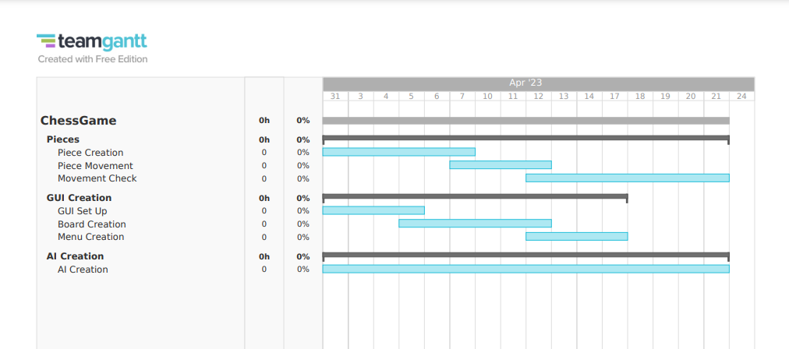
Methodology cont.

Slide 8
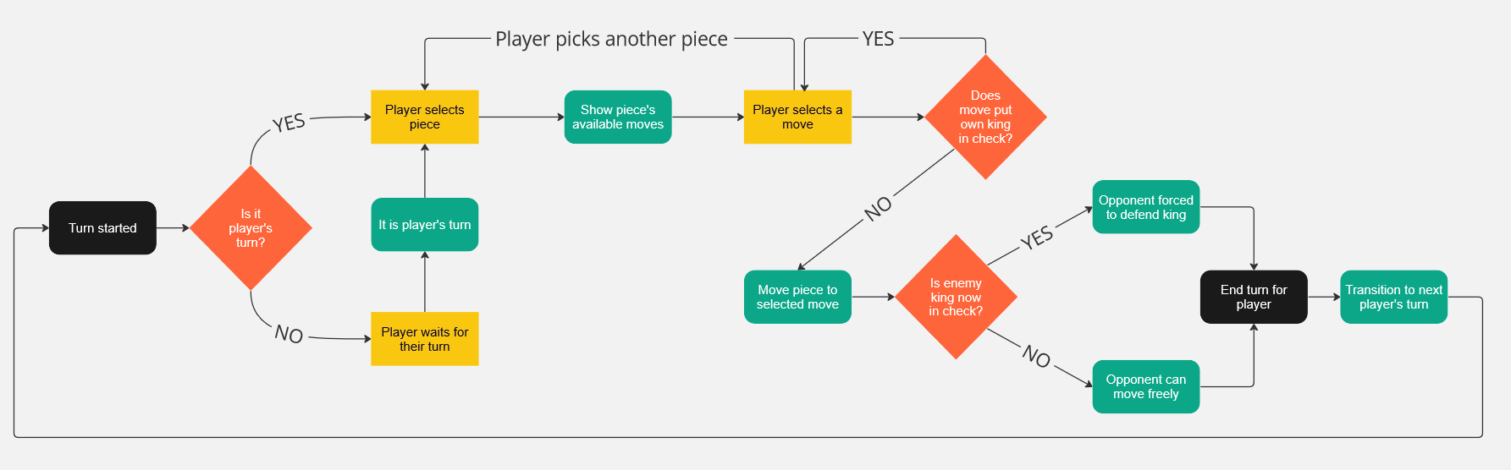
Methodology – Flowchart

Slide 9
Conclusion
The chess project will be separated into three parts: the interface, the logic/functionality, and the AI for the computer opponent.
Each member will be responsible for their designated section, but group members aren’t restricted to work just in their section.
Technical references will be used to understand and learn the tools the group is working with.
Ethical dilemmas will be considered during the design and development of the application.
Project objectives will be achieved by following the timeline and meeting the milestone deadlines (completion of each task).

Slide 10
THE END

